Slide 1
Critical Design Review: Traybot
James Ravenhill- 10699148, Ben Evans - 10362555

Slide 2
Scope
Introduction-recap
Project goals
Feedback from PDR
Design with justification
Simulation
Gantt Chart so far
Hold all questions until the end

Slide 3
Mission Statement
"Traybot is to be used for logistical purposes including delivery of food or medical supplies to patients suffering from infectious diseases in order to reduce the risk to Doctors/nurses as well as freeing valuable time allowing the hospital staff to conduct more important tasks. The Traybot should be easy to sanitise as well as create a healthy Robot-Patient and Robot-Hospital relationship."

Slide 4
The Main goals
Create a Mechanism for the Robot to vertically in order to reach various tray heights - Linear actuators.
Create a tray mechanism which can retrieve as well as dispense trays – unique tray mechanism.
Create a Wheelbase which can cope with smooth floor surface, which will allow the robot to be as agile as possible- Two differential drive wheels + two caster wheels
Create a simple air filtration system- V6 air filter and two fans along with UVC light.

Slide 5
PDR feedback
Breaking issue for wheelbase
Tray mechanism
Finishing touches-add rails, vent covers etc...

Slide 6
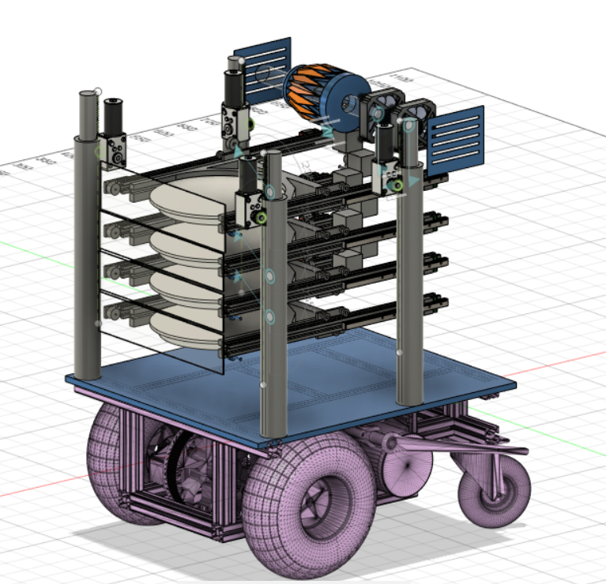
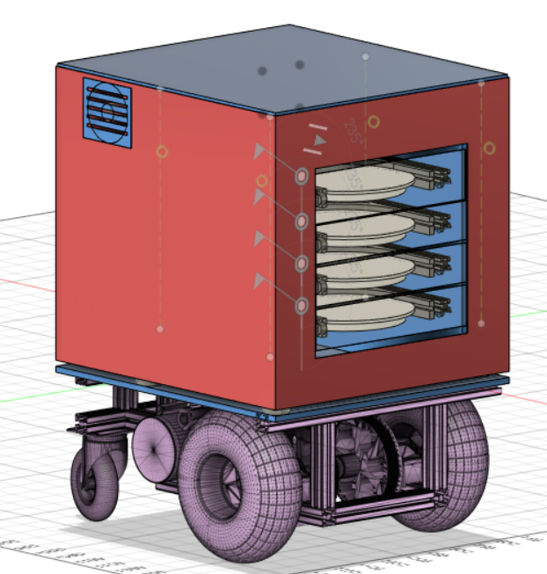
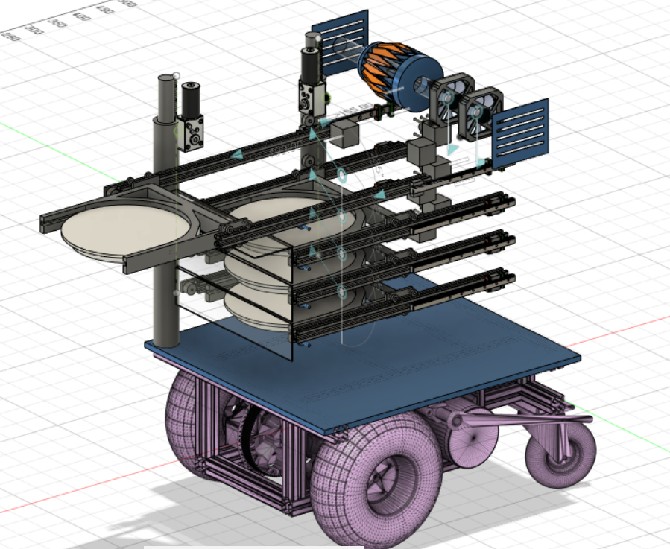
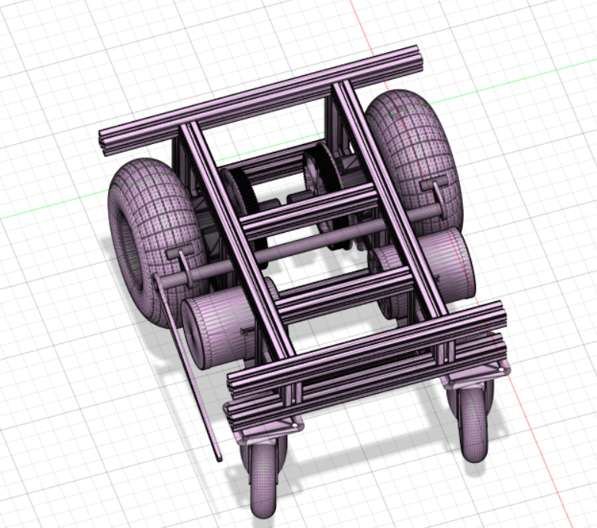
Design

Slide 7
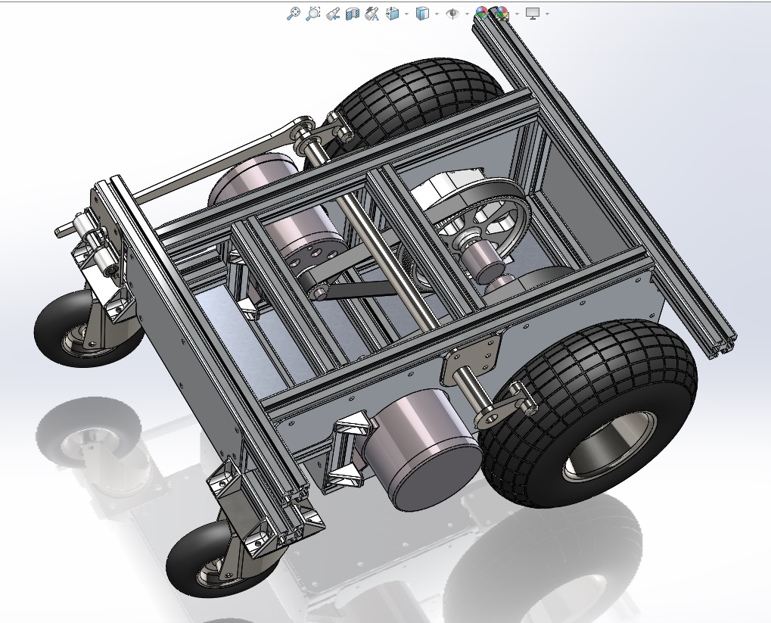
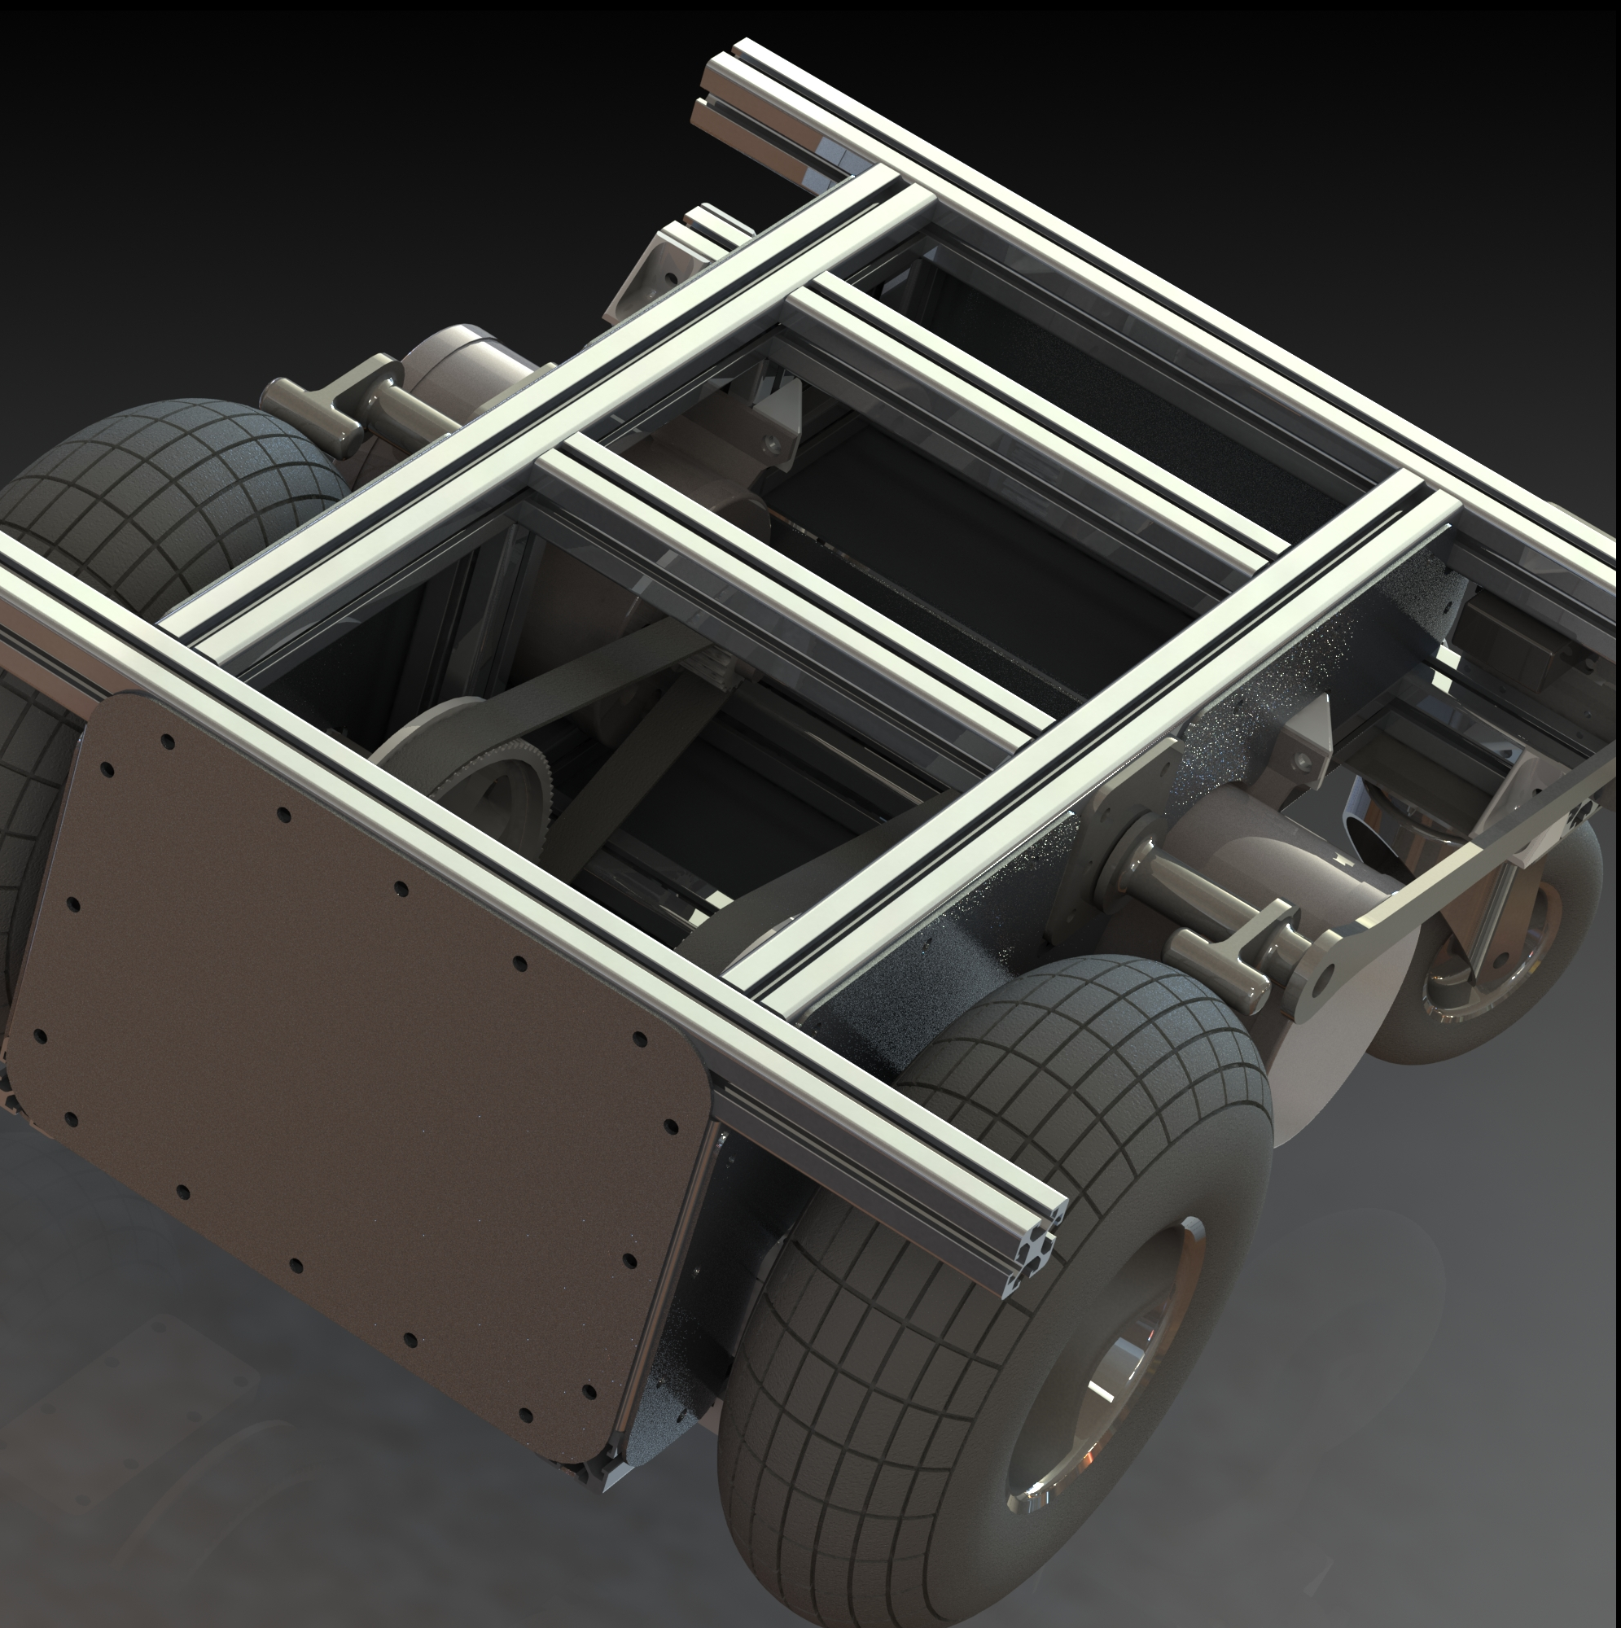
Mobile base
Functional components affordable and widely available
Removable outer panels allow easy access
Quadrature encoders provide ~0.68mm positioning
>106 N force per driven wheel

Slide 8
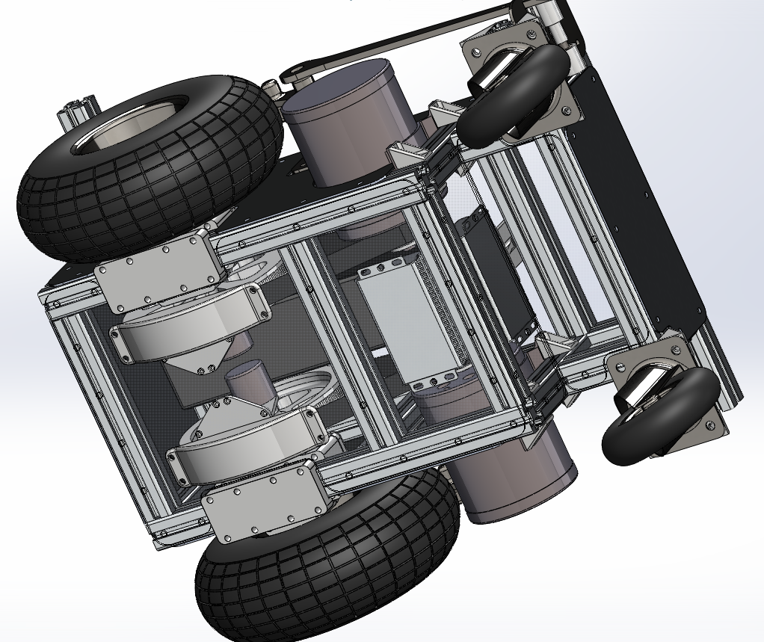

Slide 9
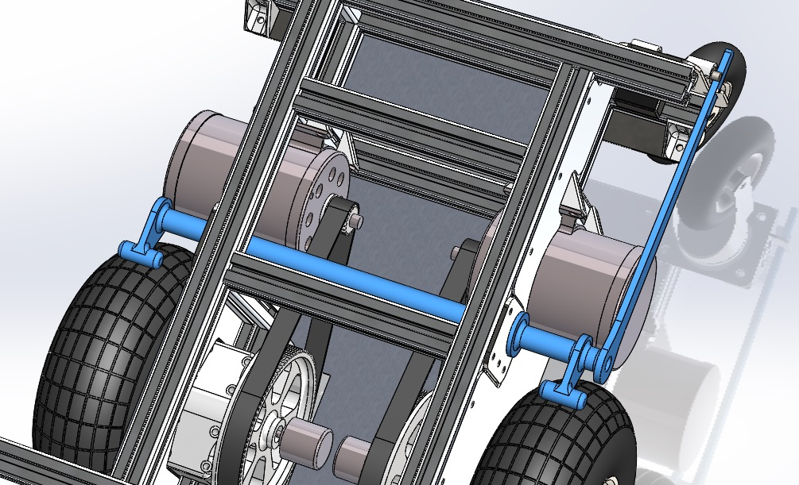
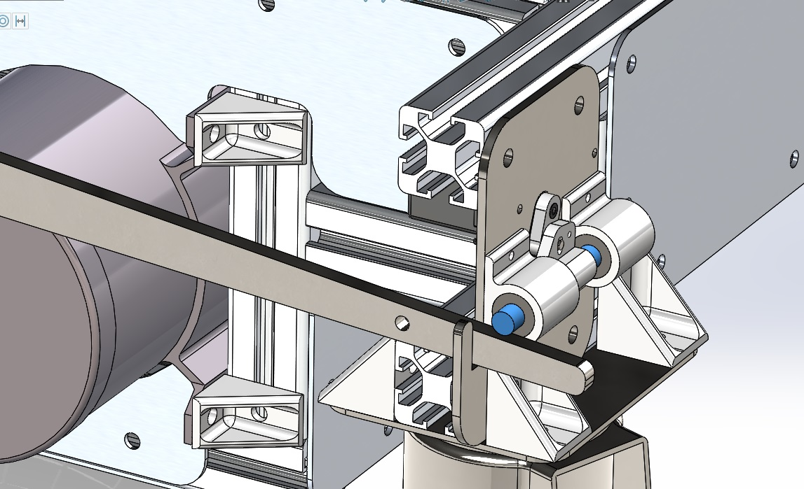
Failsafe breaking
Sprung braking bar applies friction directly to tyres
Set manually, powerful actuators are not required
Locking pin releases upon interruption of power, or software trigger
System unaffected by belt/pulley failure

Slide 10
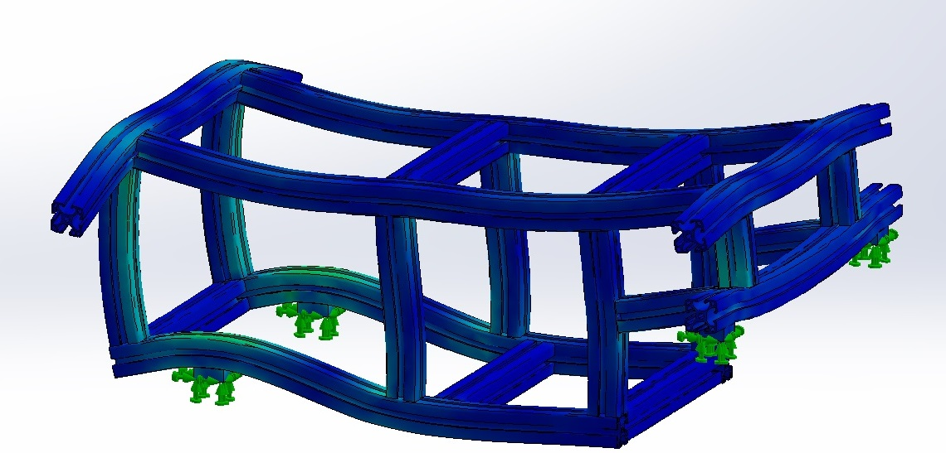
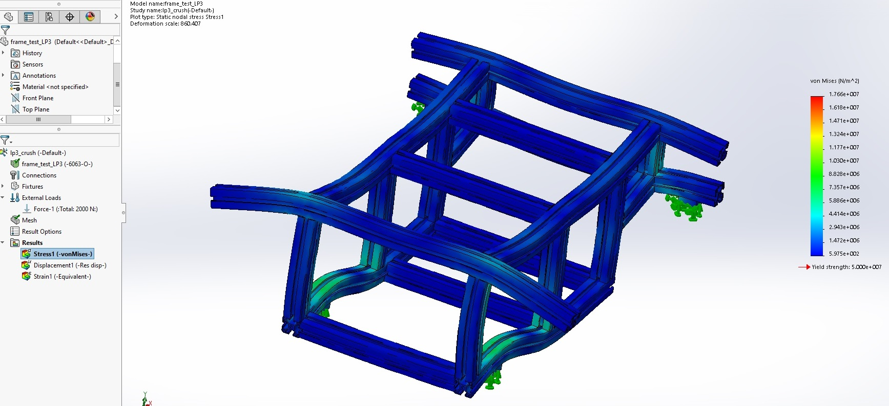
FEA
Aluminum frame bears a 200kg load within safe limits

Slide 11
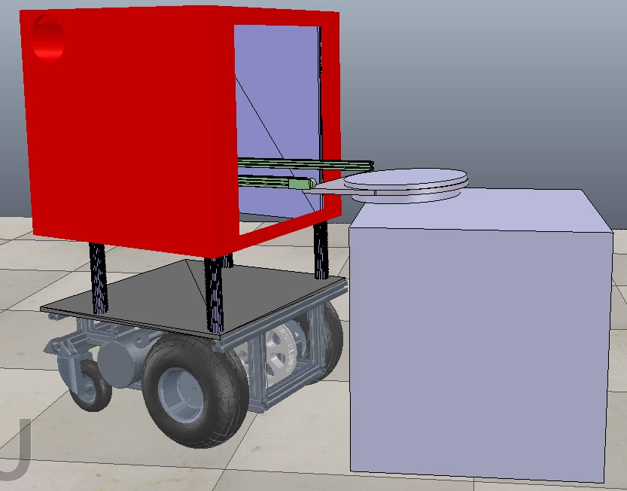
Simulation
Proof of concept- Design can reliably pick and place trays
Differential drive acts as yaw positioning
Telescoping arm allows further reach

Slide 12
Fail safes and other safety issues.
Some mechanical and others are down to the programming.
Wheelbase breaking mechanism
Centre of mass as low as possible- e.g. Lead batteries in the base
Offload one tray at a time
Do not pick up overloaded trays
When moving around the environment (hospital) use a flashing beacon.

Slide 13
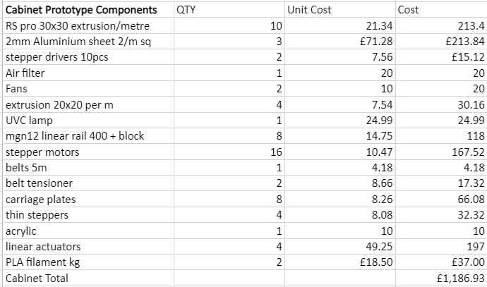
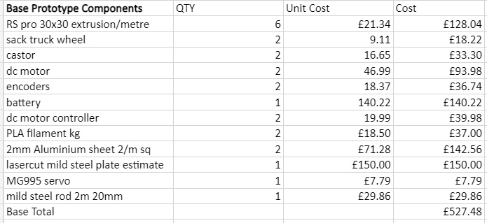
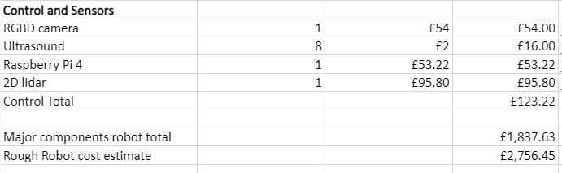
Cost and materials

Slide 14
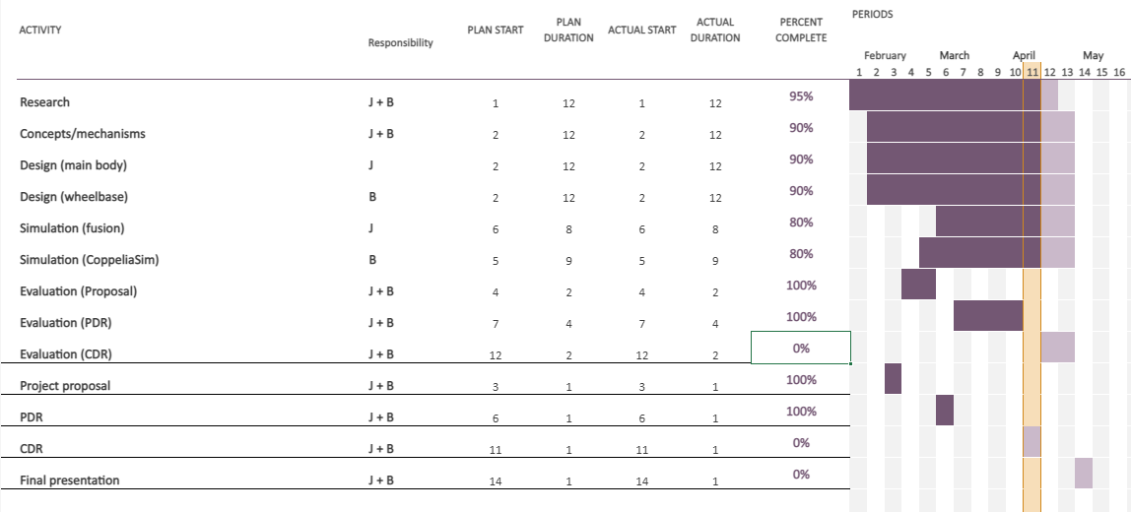
Gantt Char

Slide 15
Thank you for listening. Questions??

